Slide 1

Ferrara
Brand Websites & Drupal Support Weekly Report
Sep 19th - Sep 23th 2022
Multiple product channels Support
SLP (Shopable Landing Page)
Product Related support on Destini
Prepared by: metacube

Slide 2
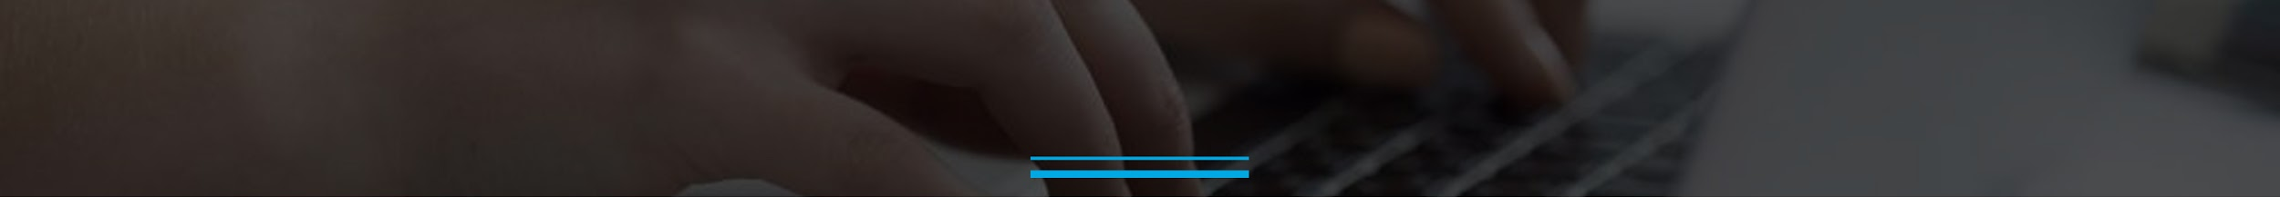
Brand Websites Support Progress
Brand Websites Support | Team Size: 3 Period: Sep 19th - Sep 23th
Completed Activities
[FerraraUsa] - Remove documents from Corporate Site. Update 'New Vendor Kit' - DONE
[FerraraUsa] - Mixed Bag Shopable Landing Page (SLP) - DONE
[Funables] - Shopable Landing Page Update Request - DONE
To Do / In Progress Activities
[Trolli] - Issue on Mobile (iPhone)
[Nerds] - Fixes to Nerds Dev Site
[Now And Later] - Website Content Refresh
[FerraraUsa] - Corporate Site Updates
Setting up Repos in Local(Still waiting for DB back file , should be provided from Ferrara side)

Slide 3
Retrospective
What Went Well
Tickets are resolved on time
Docs are clear to fulfill requirement gathering
Jeera Tickets are created for relevant task
What can be Improved
Technical Queries should be resolved more faster

Slide 4


